Slide 1
The Life Styles Inventory™ (LSI)

Slide 2
Meta Change Process
Action
Acceptance
Awareness

Slide 3
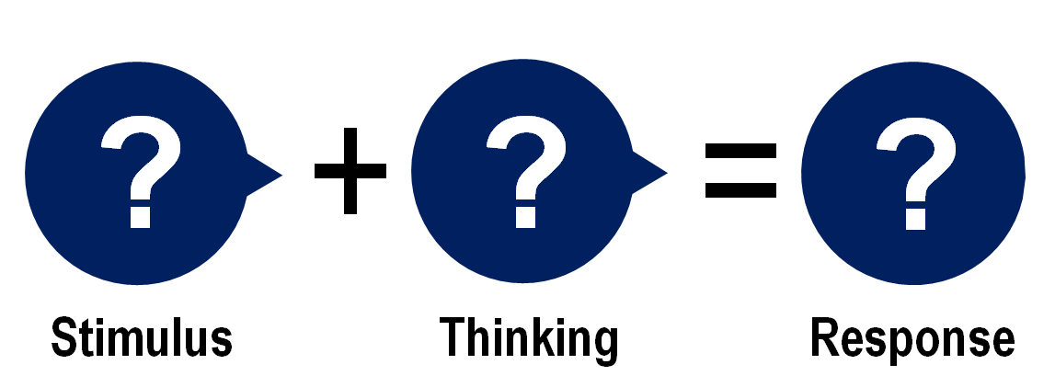
S + T = R
LSI 1
LSI 2
Measures thoughts and attitudes that motivate your behaviour.
Provides feedback on how your behaviour patterns are interpreted by others:
How you relate to others
How you solve problems and make decisions.

Slide 4
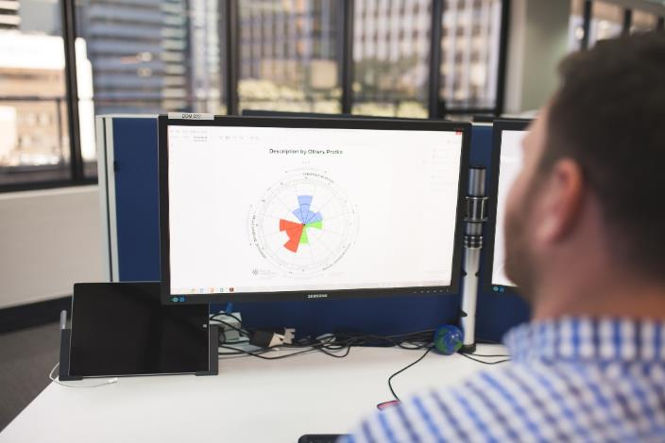
The LSI…
Assesses individual thinking styles, personal effectiveness and satisfaction.
Presents feedback on individual behaviour and effectiveness.
Provides insights into strengths and areas for development.
Focuses on self-development and is confidential.
Has been designed as a continuous and prescriptive tool for individual development.
Is scientifically valid and reliable.
Has over 40 years of use and research.
Is referenced in numerous MBA programs, management books, psychology books, peer reviewed journals, and newspapers.

Slide 5
Outcomes of using the LSI
The LSI enables individuals to think and behave to their full potential. It’s particularly valuable for helping individuals to:
Discover new ways of thinking and behaving
Improve their effectiveness in their roles
Cope better with stress, pressure and change
Achieve self-set goals
Apply more flexible and creative thinking
Improve their interpersonal relationships
Increase their personal effectiveness.
Constructive Individuals:
37% Less Stressed
26% Better Health & Wellbeing
43% Better Working Relationships
47% Greater Readiness for Promotion
34% More Effective at their Role

Slide 6
Our Measurement Model: The Circumplex

Slide 7
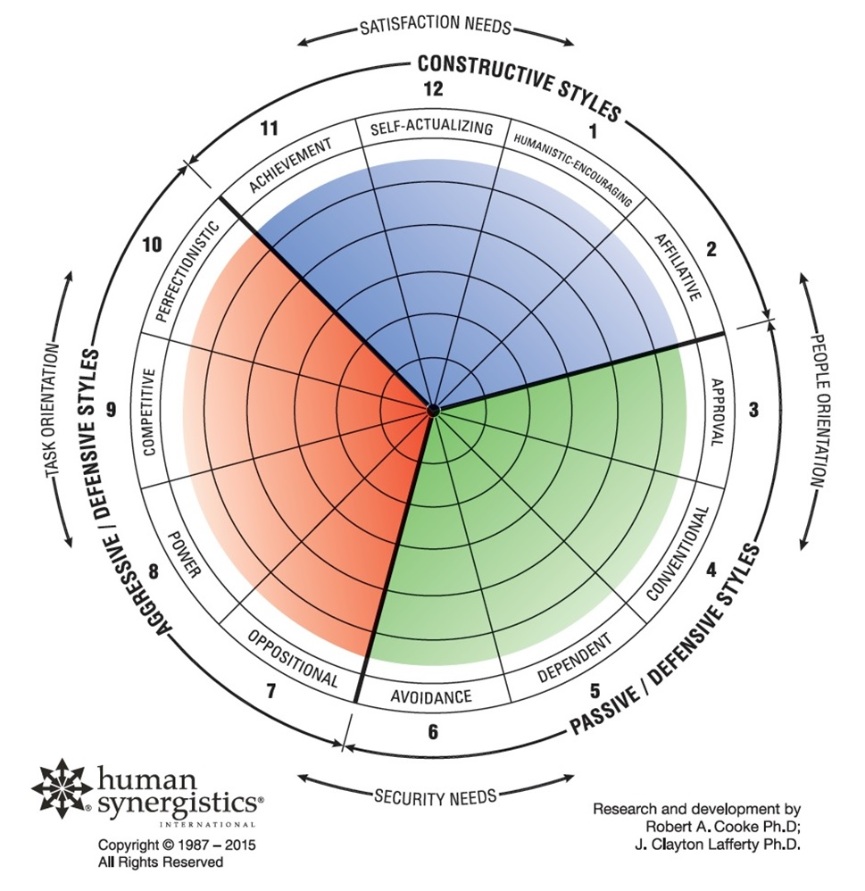
Our Model: The Circumplex
Developed 40 years ago, the Human Synergistics Circumplex provides a way to see, measure and change the thinking and behavioural styles that drive the performance of not only individuals but also groups and organisations.
3 general clusters break down the factors underlying effectiveness into 12 specific styles. They are arranged in a circular manner based on their relationship to needs (satisfaction vs. security), orientation (task vs. people) and themselves.
Research shows that organisational (motivation, satisfaction), group (collaboration) & individual (task/interpersonal effectiveness) outcomes are increased when the primary cluster is constructive.

Slide 8
Satisfaction Vs. Security Needs
Higher-order Needs
Satisfaction
Security
Lower-order Needs

Slide 9
Task Vs. People Orientation
Higher-order Needs
Task
People
Lower-order Needs

Slide 10
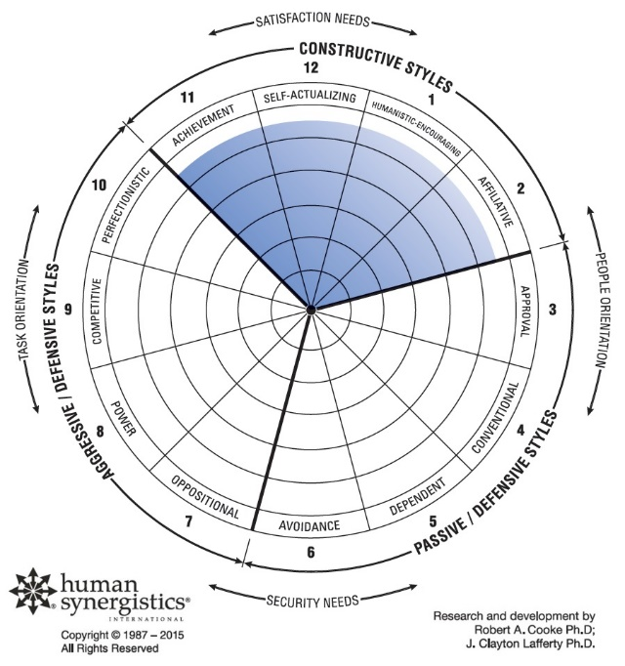
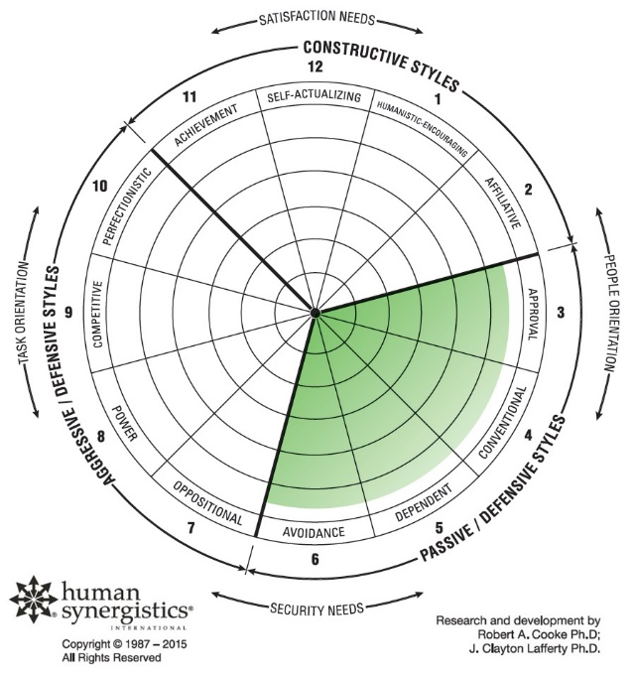
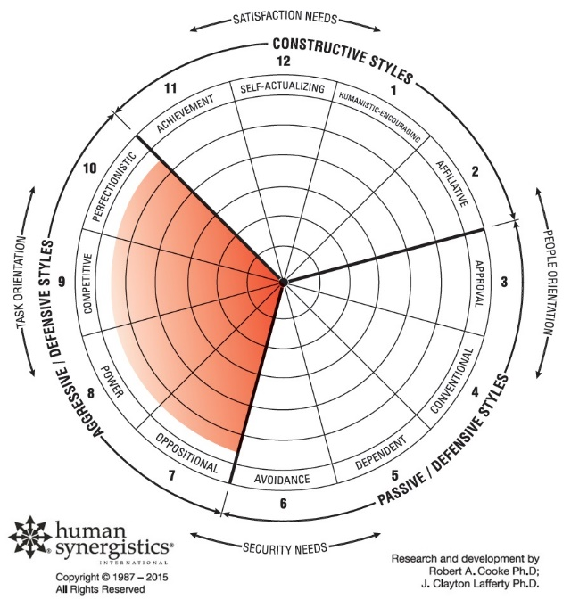
The Circumplex Styles
Constructive Styles
Passive/Defensive Styles
Aggressive/Defensive Styles
Accomplish goals
Strive
Work well with others
Innovation & creativity
Develop others
Keep out of trouble
Just do
Avoid conflict
Follow the rules
Don’t rock the boat
Prove yourself
Look good
Critique ideas and others
Control
Dominate

Slide 11
The Constructive Cluster
Achievement
Self-Actualizing
Humanistic-Encouraging
Affiliative
Members interact with others and approach tasks in ways that will help them to meet their higher-order satisfaction needs.

Slide 12
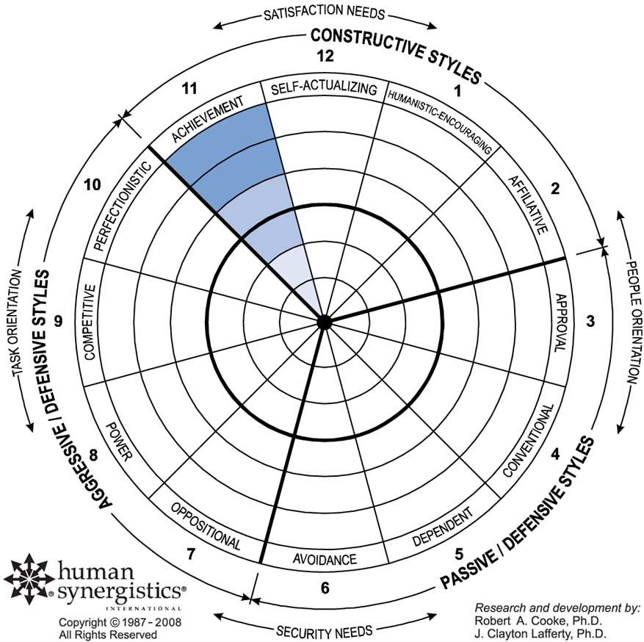
Constructive Styles – Achievement
Characterized by:
Achieving self-set goals
Believing that individual effort is important
Accepting and sharing responsibility
Taking on challenging tasks
Providing insight in diagnosing problems

Slide 13
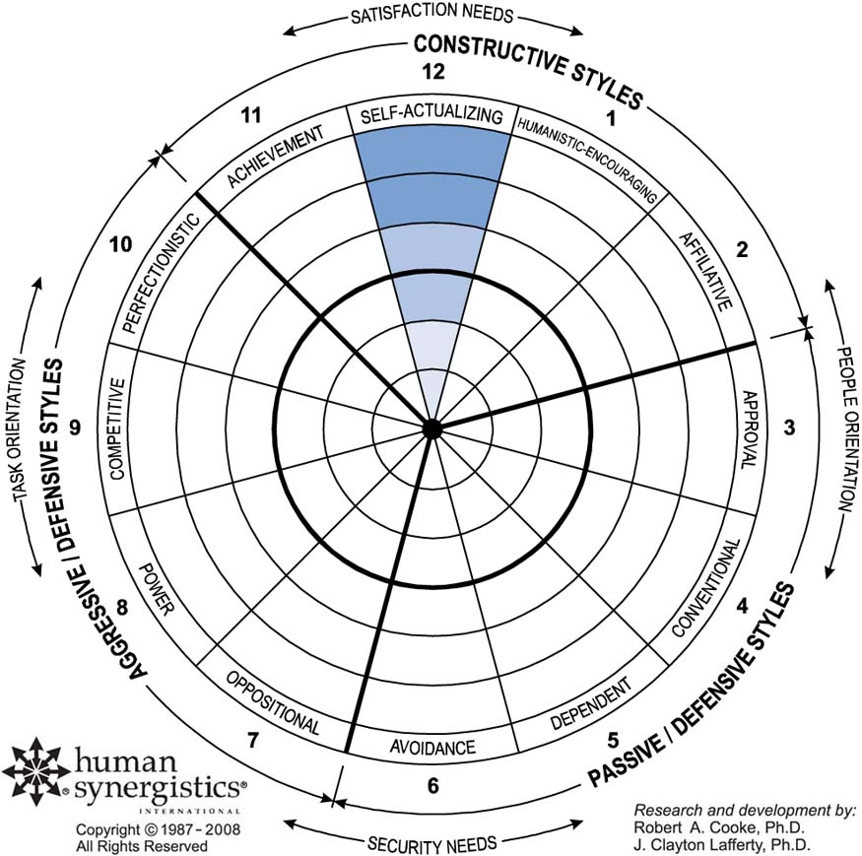
Constructive Styles – Self-Actualizing
Characterized by:
Showing a strong commitment to the organisation
Receptiveness to change
Being a creative problem-solver
Lack of defensiveness
Showing self respect achieving self-set goals

Slide 14
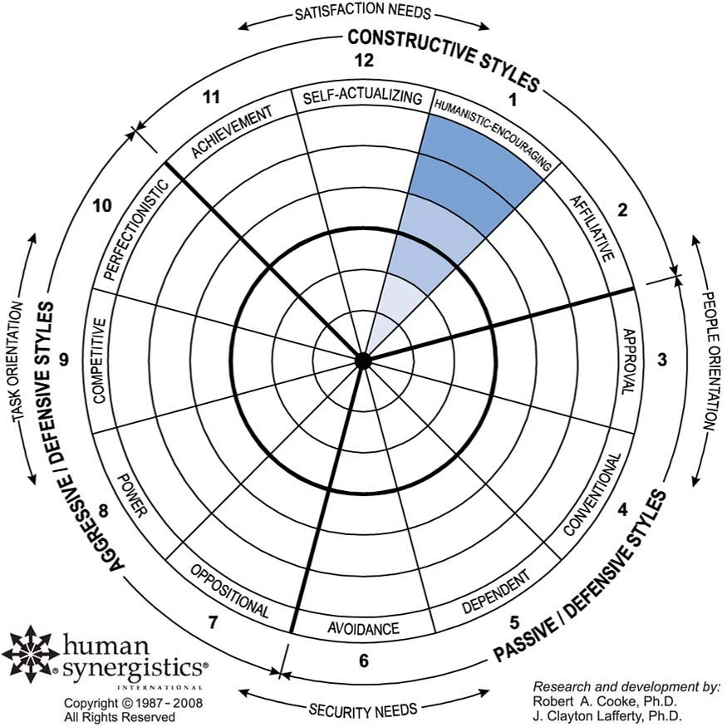
Constructive Styles - Humanistic-Encouraging
Characterized by:
Encouraging growth and development in others
Resolving conflicts constructively
Being trustworthy
Involving others in decision making
Motivating by serving as a role model

Slide 15
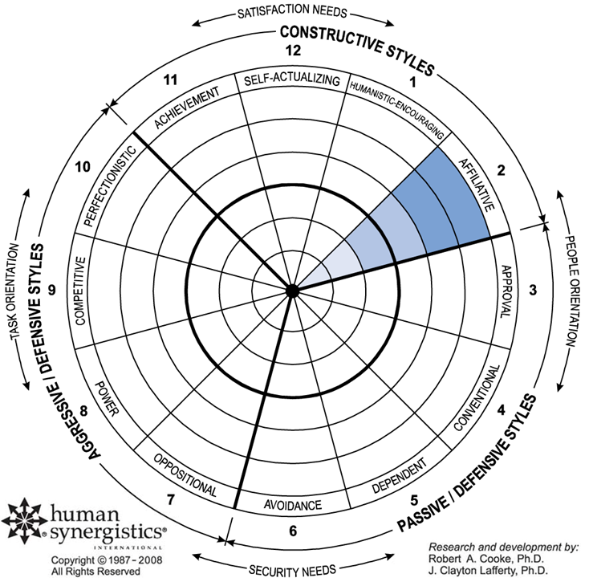
Constructive Styles – Affiliative
Characterized by:
Being cooperative and friendly
Showing genuine concern for others
Accepting change

Slide 16
The Passive/Defensive Cluster
Approval
Conventional
Dependent
Avoidance
Members interact with people in ways that will not threaten their own security.

Slide 17
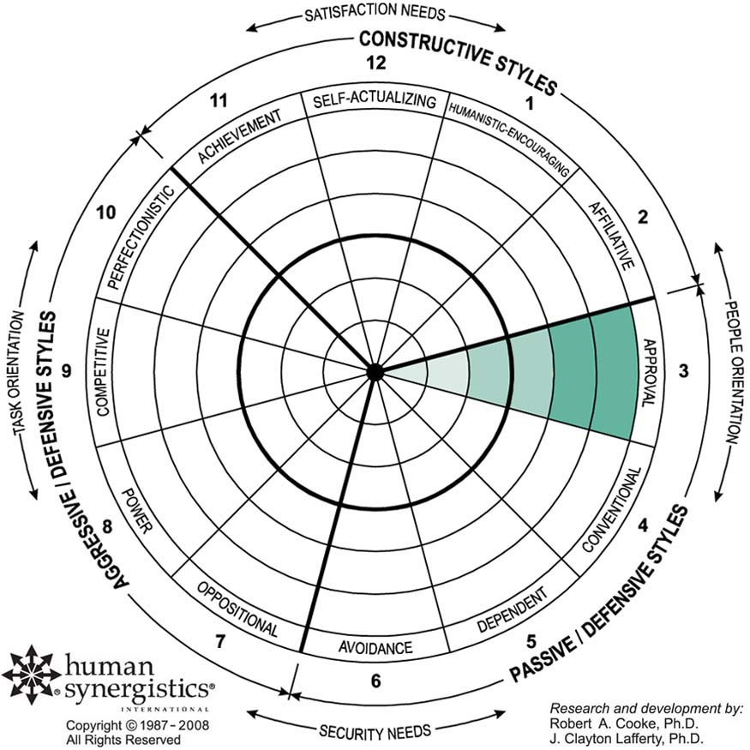
Passive/Defensive Styles – Approval
Characterized by:
Setting goals to please others
Supporting those with the most authority
Agreeing with everyone
Reluctantly dealing with conflict

Slide 18
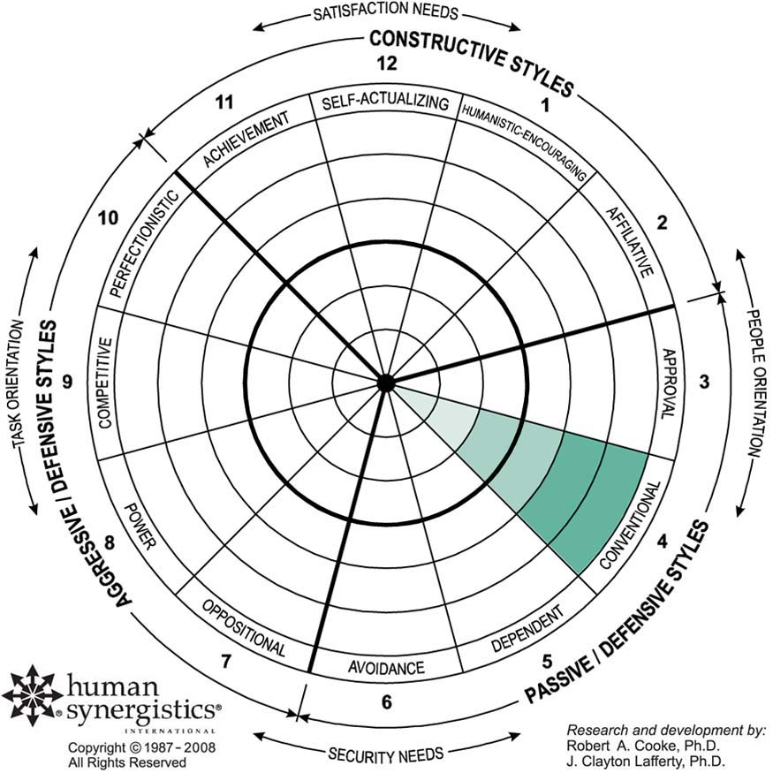
Passive/Defensive Styles – Conventional
Characterized by:
Treating rules as more important than ideas
Following policies and practices
Being reliable and steady
Setting predictable goals and objectives

Slide 19
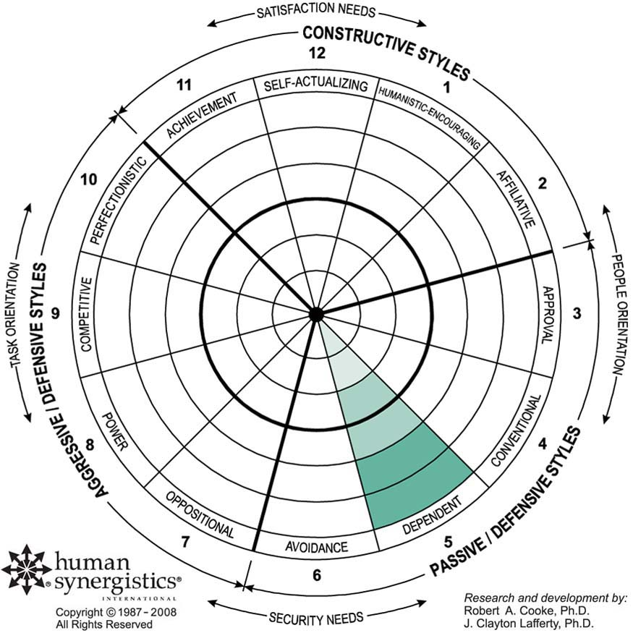
Passive/Defensive Styles – Dependent
Characterized by:
Relying on others for direction
Being a good follower
Not challenging others
Aiming to please everyone

Slide 20
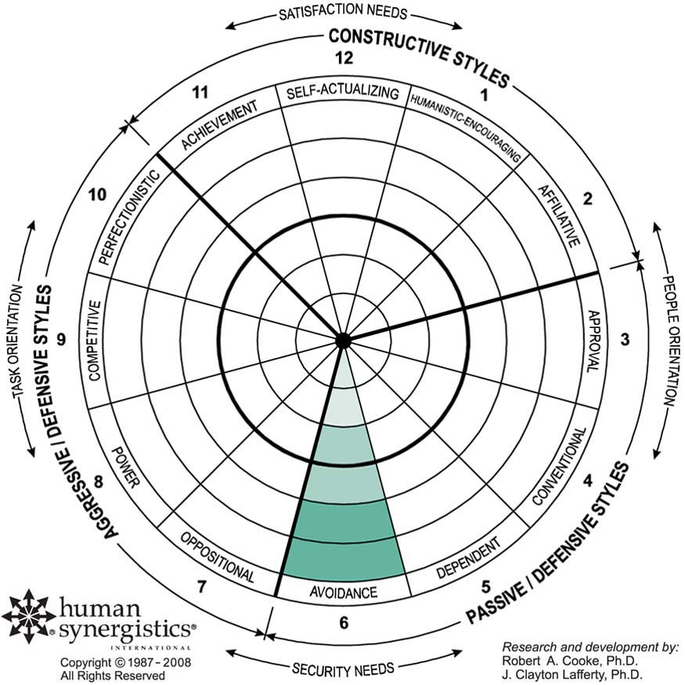
Passive/Defensive Styles – Avoidance
Characterized by:
“Laying low” when things get tough
Avoiding conflict
Having difficulty making decisions
Being non-committal
Hoping that problems will take care of themselves

Slide 21
The Aggressive/Defensive Cluster
Oppositional
Power
Competitive
Perfectionistic
Members approach tasks in forceful ways to protect their status and security.

Slide 22
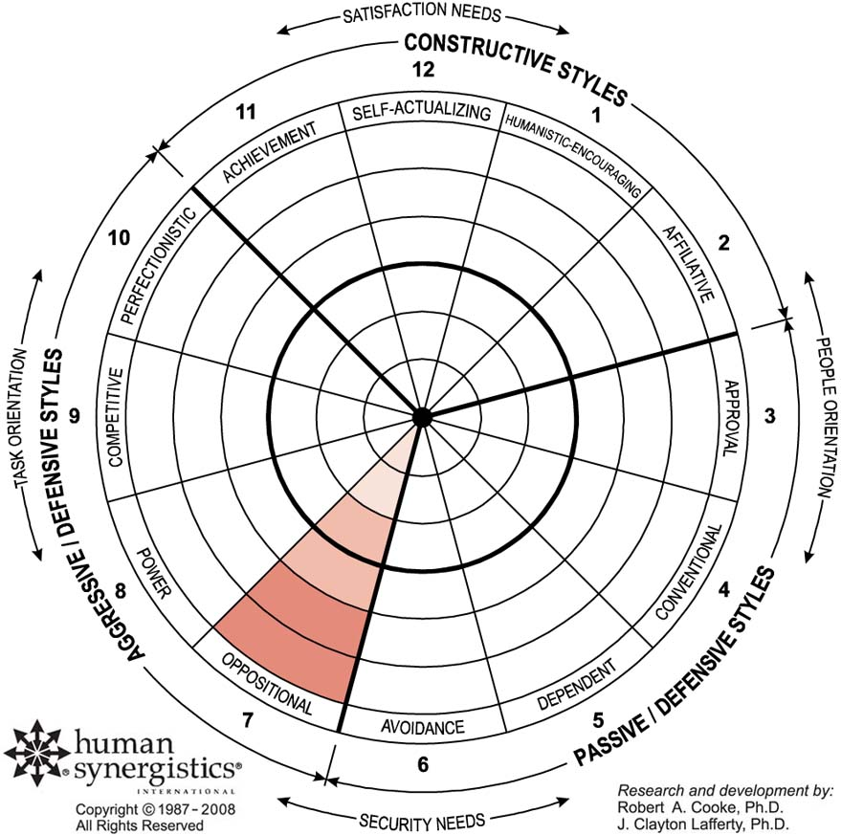
Aggressive/Defensive Styles – Oppositional
Characterized by:
Opposing new ideas
Looking for mistakes
Resisting change
Being critical of others

Slide 23
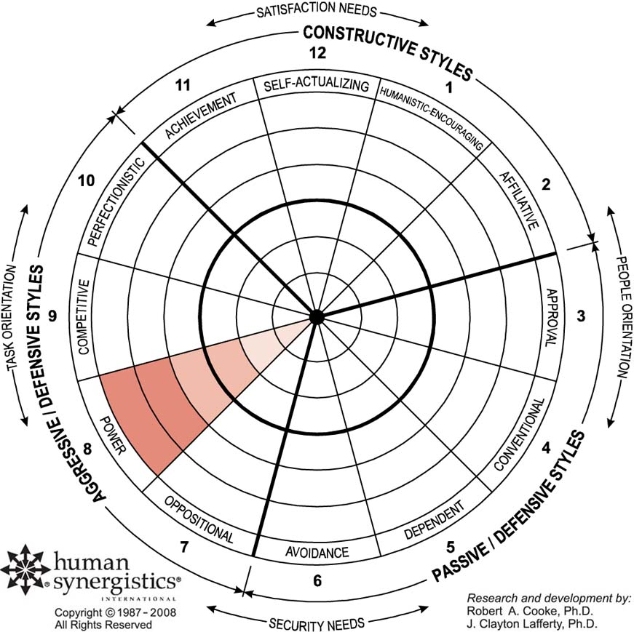
Aggressive/Defensive Styles – Power
Characterized by:
Wanting to control everything
Believing in force
Having little confidence in people
Seldom admitting mistakes

Slide 24
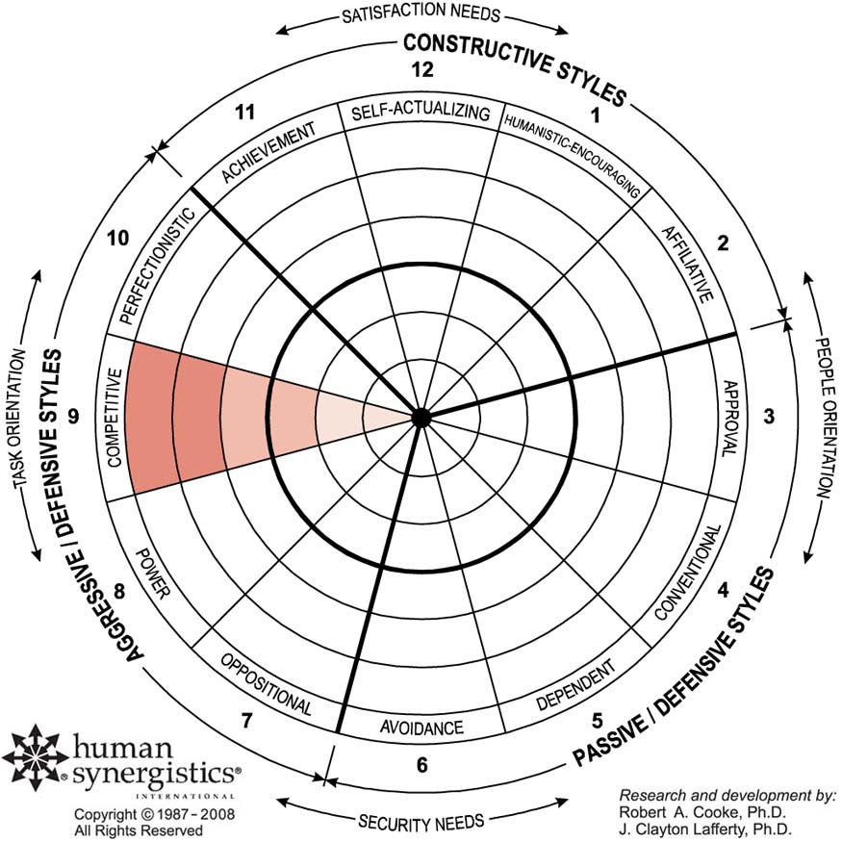
Aggressive/Defensive Styles – Competitive
Characterized by:
Competing rather than cooperating
Having a strong need to win
Constantly comparing self to others

Slide 25
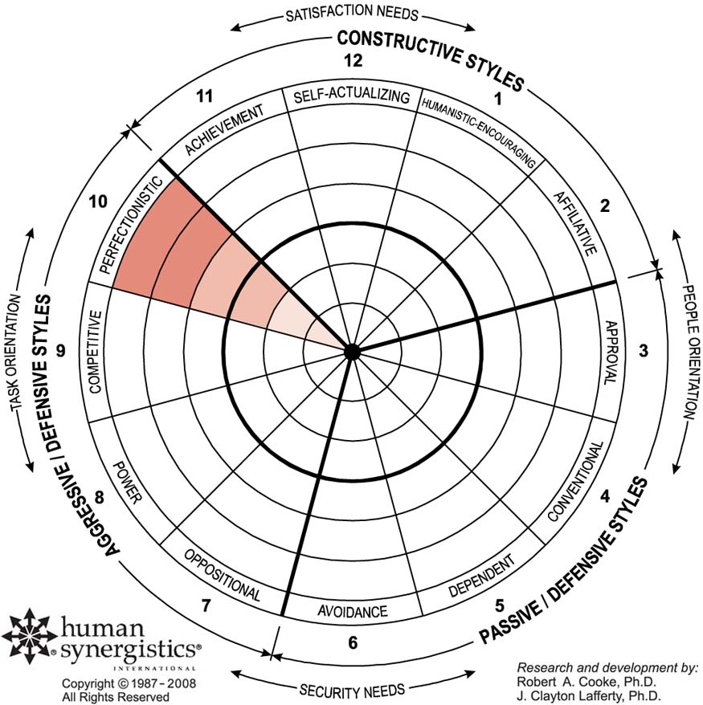
Aggressive/Defensive Styles – Perfectionistic
Characterized by:
Never wanting to make a mistake
Setting unrealistic goals
Personally taking care of everything
Creating self-induced stress

Slide 26
Giving Feedback

Slide 27
Giving Feedback
3
Ensure Confidentiality
Be mindful of Reactions to Feedback
2
4
Bargaining
Anger
Depression
1
Shock & Denial
5
Acceptance

Slide 28
LSI 1 & 2 Debriefing Materials

Slide 29
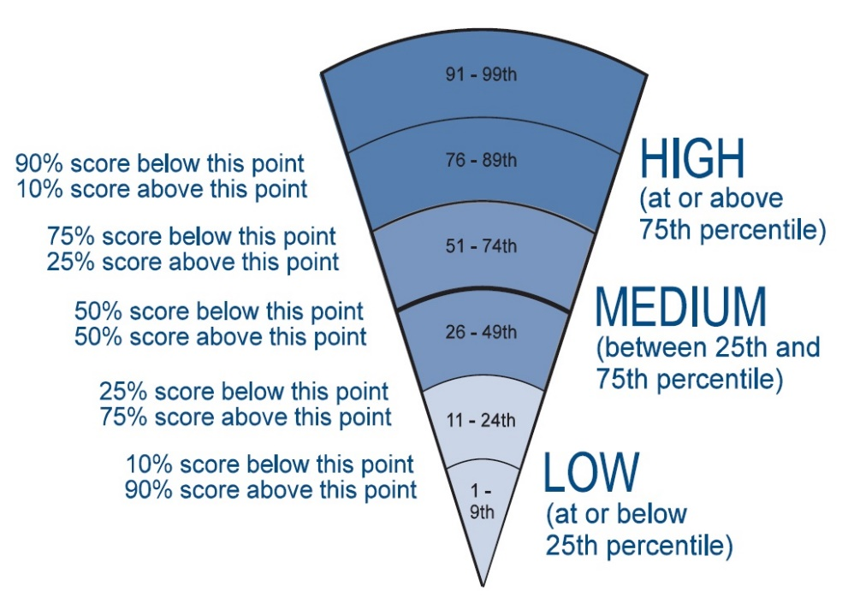
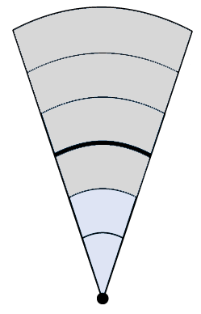
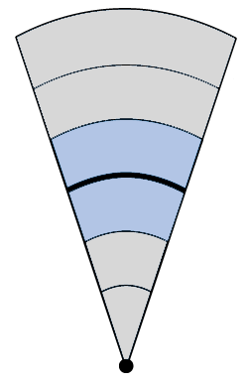
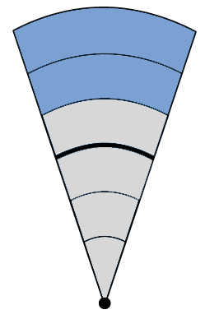
The Circumplex Percentiles
LOW
MEDIUM
HIGH

Slide 30
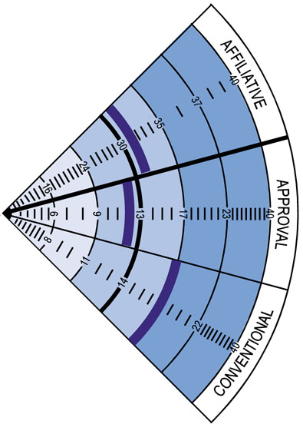
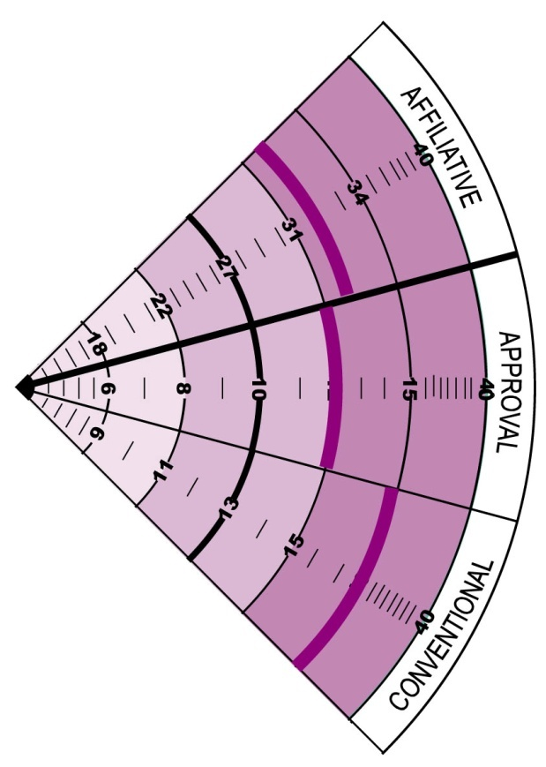
Our Global Norms
N = 14,000 focal individuals
Matched LSI 1 and LSI 2 (same 14,000 individuals)
19.8% of the dataset comes from the Australian database
3.7% New Zealand
16% respondents ‘Asian’ (ethnicity)
LSI-1
Self Description
LSI-2
Description by Others

